Slide 1
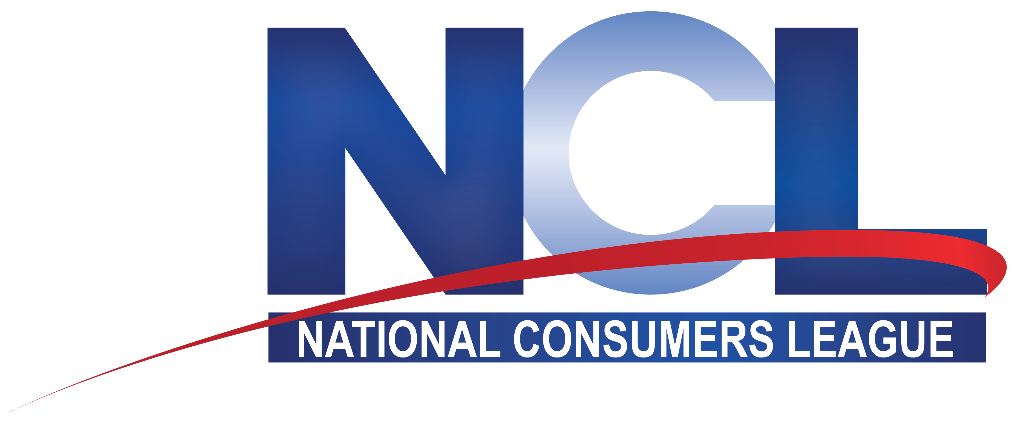
For confidence and safety in the marketplace since 1899
nclnet.org

Slide 2
340B and Medical Debt Campaign
Lisa Bercu, JD
Senior Director of Health Policy
National Consumers League​

Slide 3
National Consumers League
NCL is the nation’s pioneering consumer and worker advocacy organization​​
Engages on key issues including medication information, food safety, child labor, and privacy ​​
Champions access to healthcare, drug affordability, safe medication use, and science-based policies
National Consumers League | nclnet.org

Slide 4
340B Reforms
NCL supports the original intent of the 340B program to ensure low-income and uninsured patients can afford and access their medications and care​
Concerned that 340B savings are not being passed on to patients, and that hospitals, the pharmacies they contract with, and PBMs are pocketing drug discounts for profit​
Patient-centered reforms are needed so that the program:​
Directly benefits low-income and uninsured patients​
Prohibits aggressive debt collection practices​
Mandates transparent reporting on savings utilization
National Consumers League | nclnet.org

Slide 5
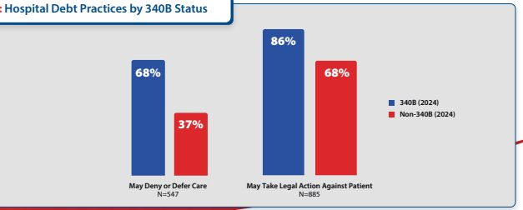
Medical Debt
NCL has long raised concerns about medical debt ​
NCL analyses found that 340B hospitals approach medical debt collection more aggressively than non-340B hospitals ​
Are two times more likely to defer or deny care for patients with existing medical debt​
Are more likely to take legal action, such as suing patients for past-due balances
National Consumers League | nclnet.org

Slide 6
National Survey
NCL/Morning Consult national poll of 20,000 American adults on medical debt and 340B perceptions​
Reveals overwhelming concern about medical debt and strong public demand for comprehensive 340B reforms​
Medical debt has impacted a majority of American adults​
25% of U.S. adults currently have medical debt and 29% had it previously​
Strong support for policies to tackle medical debt ​
e.g., Requiring providers to offer payment plans; prohibiting the denial of care due to pre-existing medical debt​
Familiarity with 340B is low: like the concept but not the abuses​
Believe 340B reform is urgently needed​
79% say reform of the 340B program should be a top priority for lawmakers
National Consumers League | nclnet.org

Slide 7
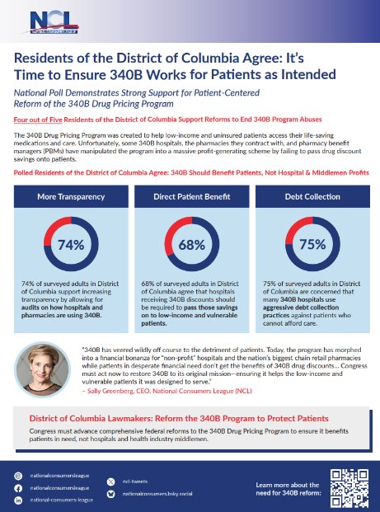
50 State Fact Sheets
Released 50 state fact sheets breaking down the data at the state level—highlighting Americans’ concerns about 340B abuses and support for patient-focused reform
National Consumers League | nclnet.org

Slide 8
Federal Advocacy
Urging Congress to advance policy reforms to bring transparency, accountability, and oversight to the 340B program ​
Grassroots campaign to engage communities to become champions for 340B reform​
Resulted in over 130,000 constituent letters to Members of Congress ​
Currently asking champions for patient stories (e.g., surprise costs; aggressive debt collection practices) that we can use to highlight abuses​
Developed handout to educate congressional offices​
Influence ads targeted to key congressional offices
National Consumers League | nclnet.org

Slide 9
Op-Ed and Educational Materials
CEO Sally Greenberg opinion piece in RealClear Health​
“Created with the best intentions, the 340B Drug Pricing Program was designed to help low-income and uninsured patients access their medications through drug manufacturer discounts to hospitals. Instead, sadly, 340B has veered wildly off course to the detriment of patients. Today, the program has morphed into a financial bonanza for “non-profit” hospitals and the nation’s biggest chain retail pharmacies while patients in desperate need don’t get the benefits of 340B drug discounts.”​
Educational website and video
National Consumers League | nclnet.org

Slide 10
Thank You
nclnet.org

